Slide 1


A Parent's Guide to Supporting Your Child in Maths
Braes High School 2026

Slide 2
Understanding the Course
National 5, Higher and AH Mathematics: These are the traditional maths courses. They focus on building foundational algebraic, geometric, and trigonometric skills. This is the path for students interested in STEM subjects.
National 5 & Higher Applications of Mathematics: These newer courses are all about applying maths to real-world problems. It covers topics like financial maths, statistics, and project planning. This is an excellent option for students who enjoy using maths in practical contexts.

Slide 3
Exams and Assessment
National 5, Higher and AH Mathematics: Both courses have two papers:
Paper 1: Non-calculator. This paper tests core skills and mental maths. Encourage your child to practise without a calculator.
Paper 2: Calculator. This paper involves more complex problems and requires careful use of a scientific calculator.
National 5 Applications of Mathematics: Similar to the others, this course has a non-calculator and a calculator paper.
Higher Applications of Mathematics: The assessment is split into two parts: a project (30 marks) and a question paper (65 marks). The project is an opportunity for your child to demonstrate their statistical skills in a practical, real-world context. The project is completed in class time just before the February break.

Slide 4
How We Assess Your Child's Progress
We believe in a multifaceted approach to assessment to ensure every student is on the right track. This isn't just about exams; it's about building consistent skills.
Low-Stakes Assessments
Every Two Weeks: Your child will be assessed on the material covered in the previous two weeks. This is a low-stakes approach designed to build confidence and help us identify any gaps in their understanding early.
Purpose: These regular assessments allow us to pinpoint areas where a student may be struggling and provide targeted support. It also helps students get comfortable with the rhythm of being tested, making the larger exams feel less daunting.

Slide 5
Prelims
October Assessment: All S5/6
Prelim 1:
National 5 Maths & Higher Applications: December
National 5 Applications & Higher Maths: January
Prelim 2:
All subjects: March

Slide 6
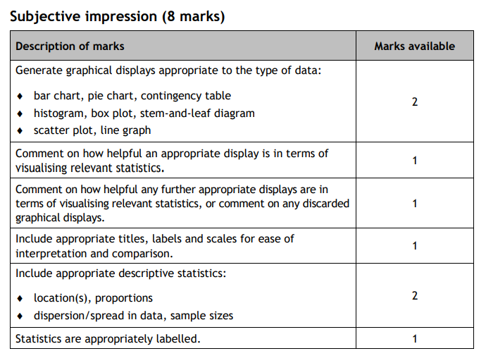
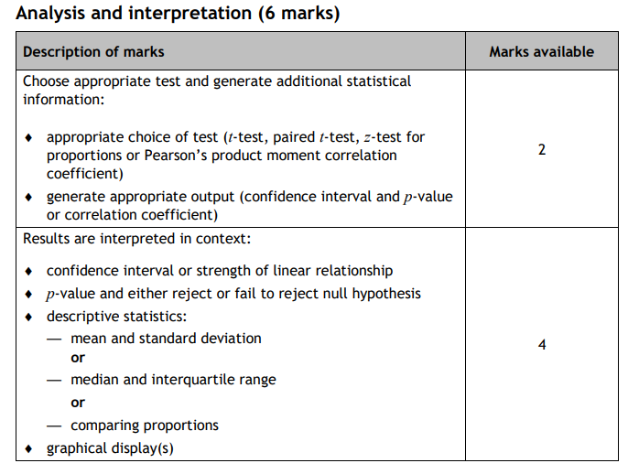
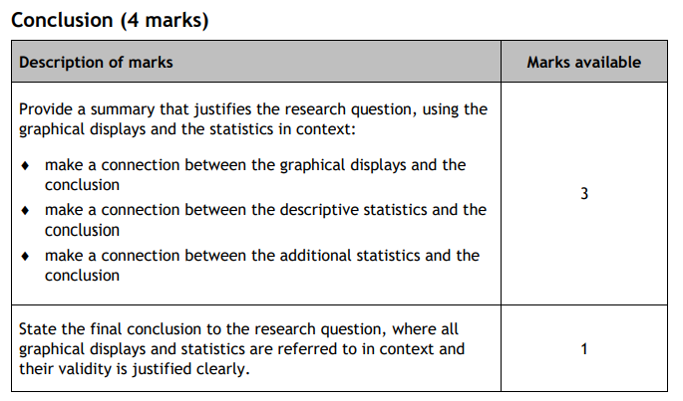
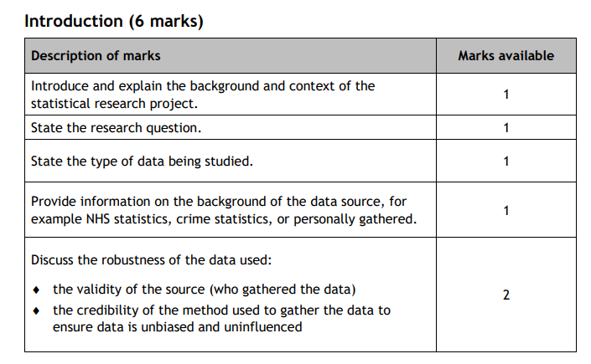
Higher Applications Project
https://www.sqa.org.uk/sqa/files_ccc/h-cat-applications-mathematics.pdf

Slide 7
Homework: A Vital Part of the Learning Process
Homework is not just busywork; it's an essential tool for building and reinforcing skills in mathematics.

Slide 8
Our Approach to Homework
Weekly Practice: Homework is issued every week to pupils at all levels. This regular practice is crucial for cementing new concepts and keeping prior knowledge fresh.
Dedicated Time: We allocate class time for students to begin or complete their homework. This gives them an opportunity to ask for help from their teacher before they go home.
Always Fully Attempt: We expect all pupils to submit their homework fully attempted. Even if they get stuck, we ask them to show their working and explain what they found difficult. This helps us to understand their thought process and target our support.

Slide 9
Our Approach to Homework
Their Own Work: Homework should always be the student's own work. While it's great for them to get support from parents, siblings, or online resources, the final submission must reflect their own understanding.
Prompt Feedback: We are committed to providing feedback on homework promptly. This feedback is meant to be acted upon, helping students to learn from their mistakes and improve for the future.Please encourage your learner to look at the feedback given. Full solutions to work will be posted on the class teams page and they should use this to review errors.

Slide 10
How You Can Help at Home
Encourage a Growth Mindset: The single most important thing you can do is to encourage your child. Remind them that mistakes are part of the learning process. The ability to learn is not fixed; it can be improved with effort and practice.
Make Maths a Routine: Consistency is key. Encourage them to do a little bit of maths every night. This could be homework, revising notes, or trying a few past paper questions. Even 20 minutes of focused work is better than a two-hour cramming session once a week.
Provide a Quiet Space: Help them create a dedicated space free from distractions like phones and social media.
Emphasise Asking for Help: Teach them that asking for help is a sign of strength, not weakness. Remind them that our teachers are here to help during class, after-school study, and lunchtime.

Slide 11
How You Can Help at Home
Use Available Resources: Remind them of the excellent resources they have access to, such as supported study, and online resources.
Talk About Maths: Ask them what they are learning. Get them to try and explain a concept to you. If they can teach it, they've mastered it.

Slide 12
Celebrate the little wins!
Completing a tough homework question, understanding a new concept, or getting a good mark on a low-stakes assessment are all reasons to celebrate.
We will acknowledge and celebrate that with them.
This positive reinforcement can be a powerful motivator.

Slide 13

Be a Cheerleader, Not a Coach
Remember, your role is to be your child's biggest fan.
While it's tempting to jump in and solve a problem for them, try to resist. Instead, ask them questions like, "What have you tried so far?" or "What does the first step in your notes say?" This encourages them to develop their own problem-solving skills, which is what will truly help them in the exam.

Slide 14
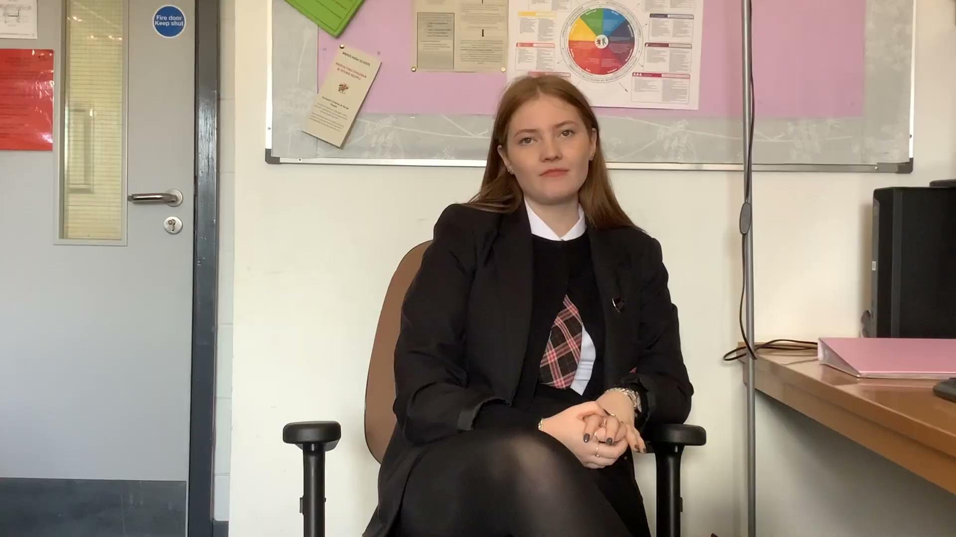

Slide 15
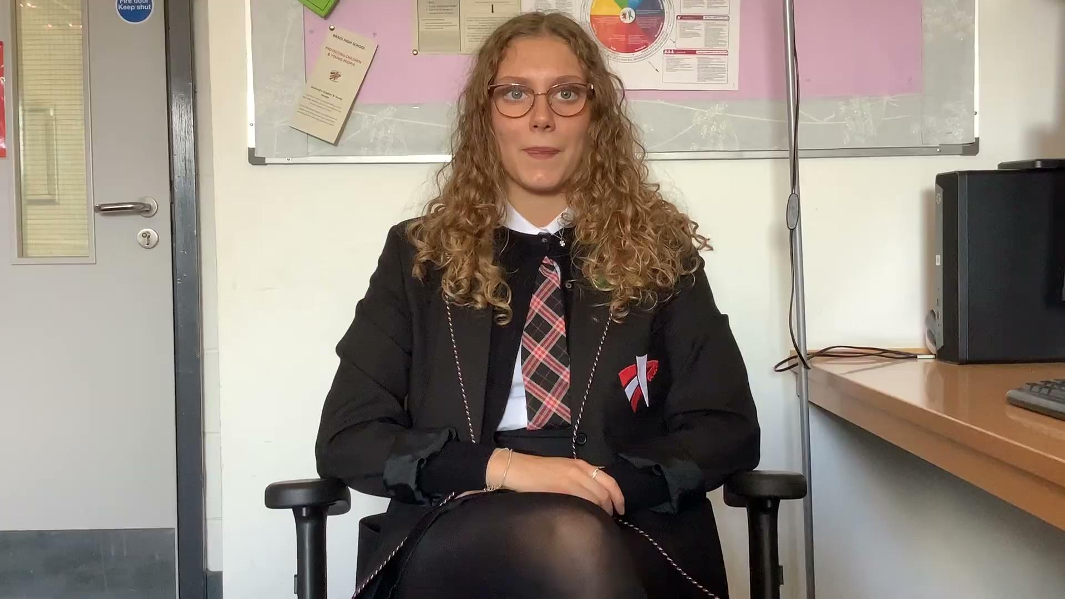

Slide 16
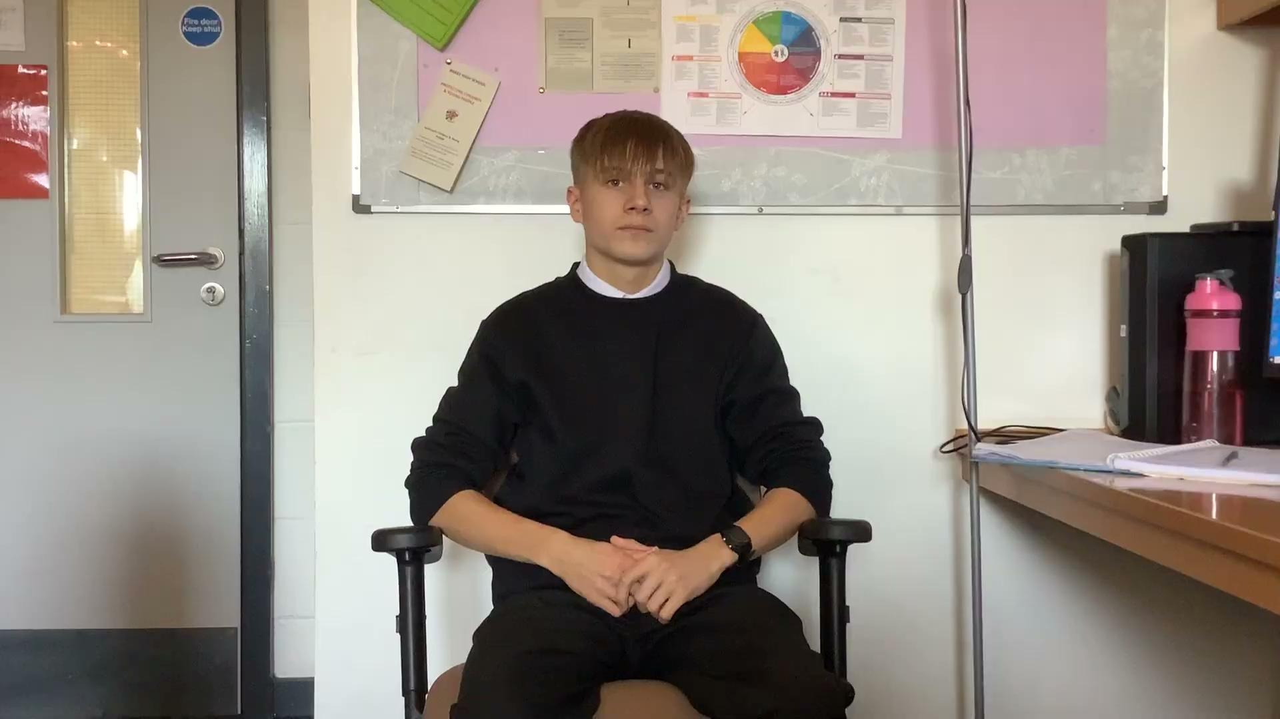

Slide 17
Key Resources for Students
Braes Maths Blog: Our department blog has notes, links to videos, and practice questions.
SQA Past Papers: The best way to prepare for an exam is to practise with past papers. They can be found on the SQA website and are a crucial part of the revision process. Topic specific questions can be found on dynamic maths.
Homework Haven: Mr Meikleham runs a drop in on a Monday lunchtime to support pupils
Small Group Supports: Our team of teachers offers additional help sessions throughout the year to focus on tricky topics. These may be topics based or exam technique. Pupils will be made aware of these throughout the year.
Larger events: Braes Maths and English study weekend, Easter School and more to follow…
Online Platforms: Encourage your child to use platforms like Achieve or Dynamic Maths which provide excellent practice questions and video tutorials.

Slide 18
The Braes RAP: Achieving in Mathematics
Rigour
It's not about being a genius; it's about being accurate.
What it means: Paying close attention to detail, showing all working, and checking answers carefully. It means knowing that a small sign error can change the entire outcome of a problem.
How to apply it: Encourage your child to double-check their work. Have them try to solve a problem a second time, maybe in a different way, to make sure their answer is consistent.

Slide 19
The Braes RAP: Achieving in Mathematics
Aspiration
It's about aiming high.
What it means: Having a belief that they can achieve the best possible result. It means not settling for a pass when they are capable of a Grade A or B.
How to apply it: Talk to them about their goals and help them set small, achievable targets. Remind them that every time they overcome a difficult problem, they are one step closer to their goal.

Slide 20
The Braes RAP: Achieving in Mathematics
Perseverance
It's about not giving up when the going gets tough.
What it means: Knowing that success in maths comes from practice, not from a single moment of inspiration. It’s about being resilient when a problem feels too hard and trying a different approach.
How to apply it: When they're frustrated, tell them a story about a time you struggled with something and eventually succeeded. Remind them that every expert was once a beginner. The path to success in maths is never a straight line.

Slide 21
Thank You
Thank you again for joining us this evening.
Your support is invaluable.
Please don't hesitate to get in touch with your child's teacher if you have any questions or concerns.
Working together, we can ensure every student has the best possible chance to succeed.
leanne.simpson@education.falkirk.sch.uk
claire.haggon@education.falkirk.sch.uk

